Slide 1
Avian Hazard Advisory System (AHAS) Training Presentation
Current as of 20 June 2014

Slide 2
OBJECTIVE
Introduce users to the AHAS system by highlighting specific capabilities, common pitfalls, and best practices
Objective

Slide 3
OVERVIEW
Background
Outputs
Current Conditions (current hour query)
Forecast Conditions (>1 and ≤ 24 hrs query)
Historical Conditions (> 24 hr query)
Common Pitfalls
Best Practices
Overview

Slide 4
BACKGROUND
Predicts bird movements within low level flight arena for the contiguous 48 states and Alaska
Found at http://www.usahas.com
Uses filtered NEXRAD data, National Weather Service (NWS) Forecasts, Migratory Bird and Soaring Bird Forecast Models, and Bird Avoidance Model (BAM) to predict bird movements
Provides CONUS and Alaska bird strike risk for:
IR, VR, and SR routes
Ranges and MOA’s
Military and Civilian Airfields
Alert Areas
Background

Slide 5
BACKGROUND
If you request information for:
Current Hour: risk is based on observations made by the NEXRAD weather radar system, data from the Migration & Soaring Models or from the US BAM
Less Than 24 hrs (>1 and ≤ 24 hrs query): risk is based on the Migration & Soaring Models (with imbedded NWS data) or the US BAM. These models forecast conditions favorable for hazardous bird activity to be present
More Than 24 hrs, or historical (> 24 hour query or past conditions): risk information comes from the current version of the US BAM
Background

Slide 6
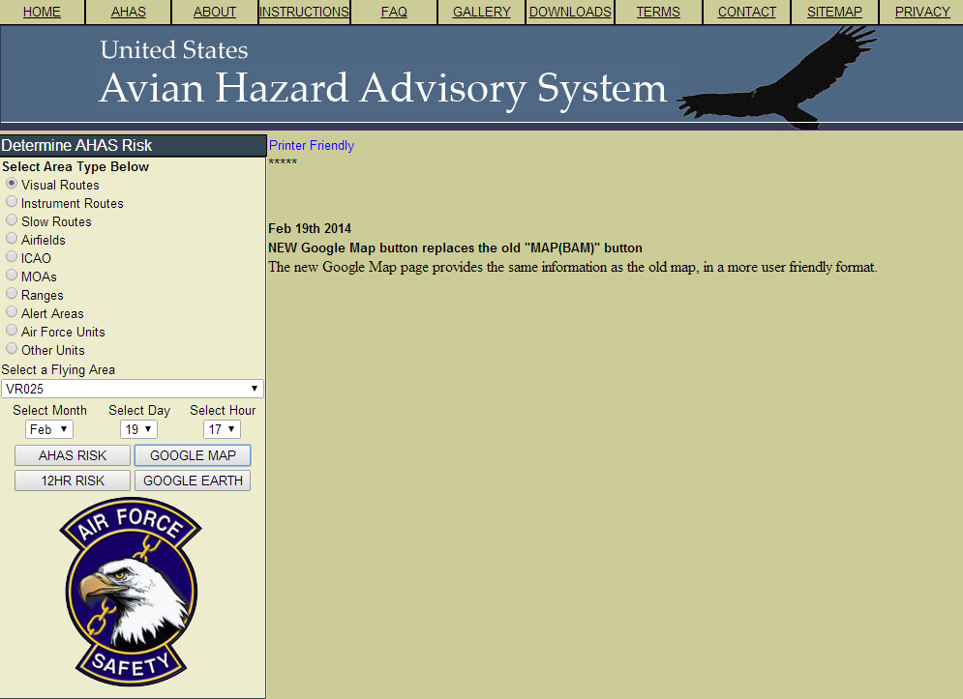
AHAS CENTRAL QUERY PAGE
AHAS immediately directs you to the query page. Check for news and other important information using the tabs at the top
AHAS now allows you to select airfields based on the ICAO
To request a unit specific page, contact the USAF BASH Team
You can also select output type
AHAS web page tabs
Select output as a table, Google Map or Google Earth
Background

Slide 7
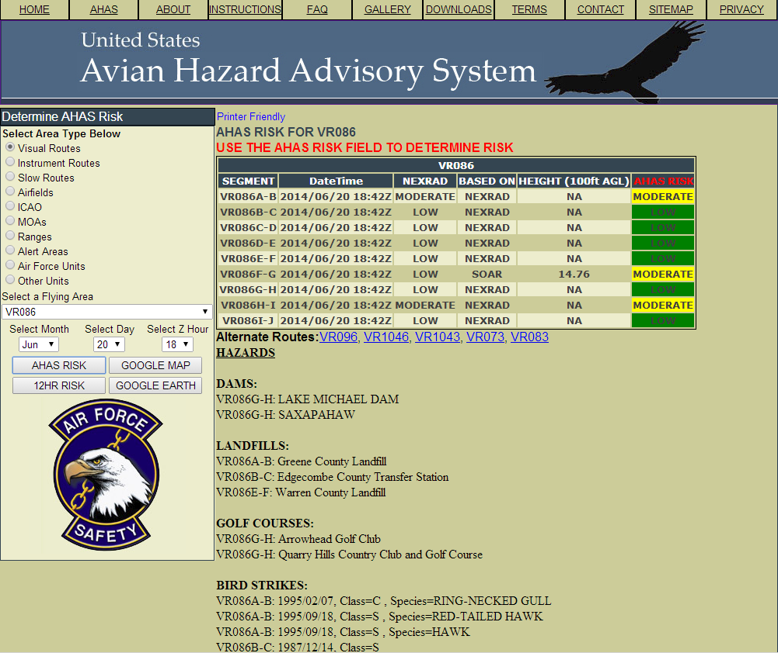
Table Output
Search Criteria: VR 086 (1, 2), current hour in Zulu (3), output choice (4)
AHAS indicates the driving model (5) for the overall risk (6)
The results from NEXRAD will always be shown for the current hour(7)
AHAS also shows the nearest five other routes(8)
AHAS now shows hazards found along the route(9)
Data auto updates every 6-10 minutes
1
2
6
7
5
3
8
4
9
Outputs

Slide 8
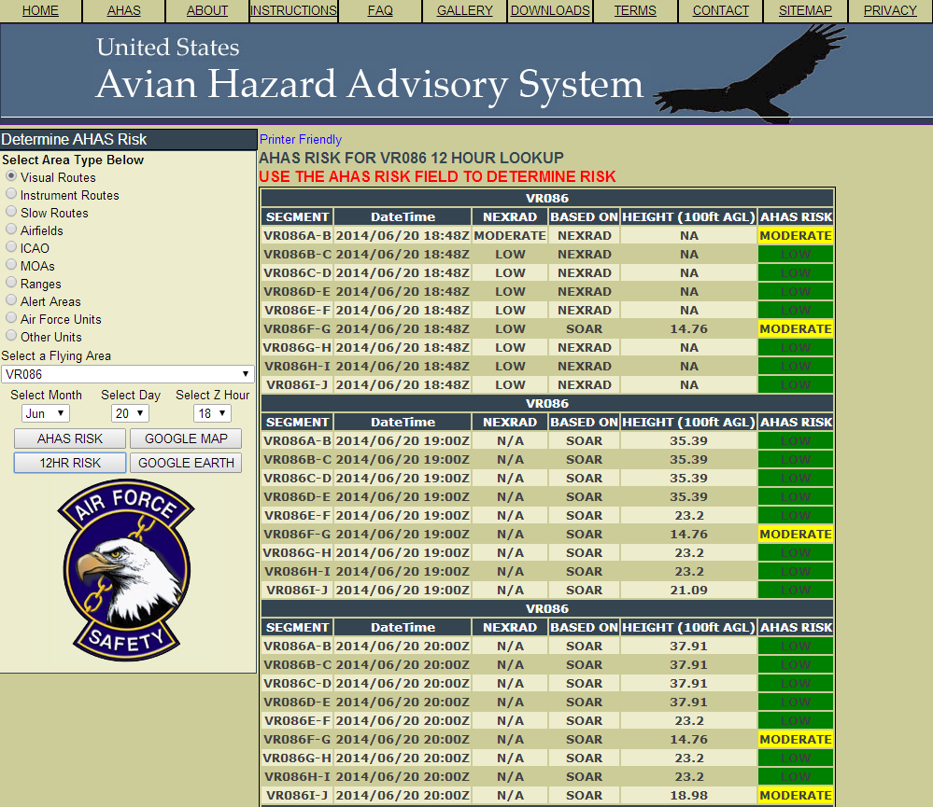
12 Hr Table Output
Search Criteria: VR 086 (1, 2), hour in Zulu (3), output choice (4)
AHAS indicates the driving model (5) for the overall risk (6)
NEXRAD risk is only available for the current hour
12 hours of risk will be shown starting at the selected hour
Scroll down for more hours (7)
No hazards or alternate routes are shown on the 12 hour web page
Expect longer download times for expanded data
1
2
6
5
3
4
7
Outputs

Slide 9
Table Output Risk determination
The AHAS risk is determined based on the highest risk between the soaring model and the NEXRAD risk
If both the NEXRAD risk and the soaring data are not available, the AHAS risk will be based on the BAM
If the NEXAD risk is missing and the soaring model is LOW, the AHAS risk will be based on the BAM
If the soaring data is missing and the NEXRAD risk is LOW, the AHAS risk will be based on the BAM
Missing NEXRAD data will be indicated on the web page as “NO DATA” in the NEXRAD column
Missing soaring data will be indicated on the web page as “NO DATA” in the Height column
Outputs

Slide 10
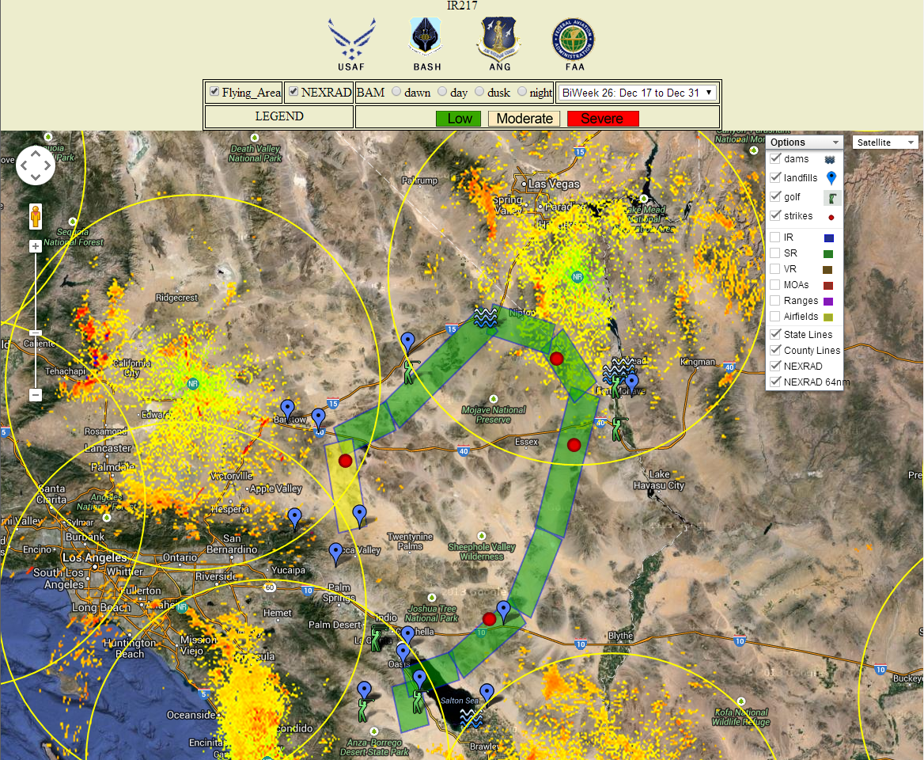
MAP OUTPUT
Search Criteria: IR217, route color based on current risk. Automatically updates every 6 minutes.
Google Map is available for unit- specific pages, but they may be very slow depending on the number of areas.
Standard Google Map features include pan, zoom and street view.
Select different BAM biweeks and periods.
May add different map options.
Map view or satellite view.
Severe risk
Low risk
Moderate risk
Outputs

Slide 11
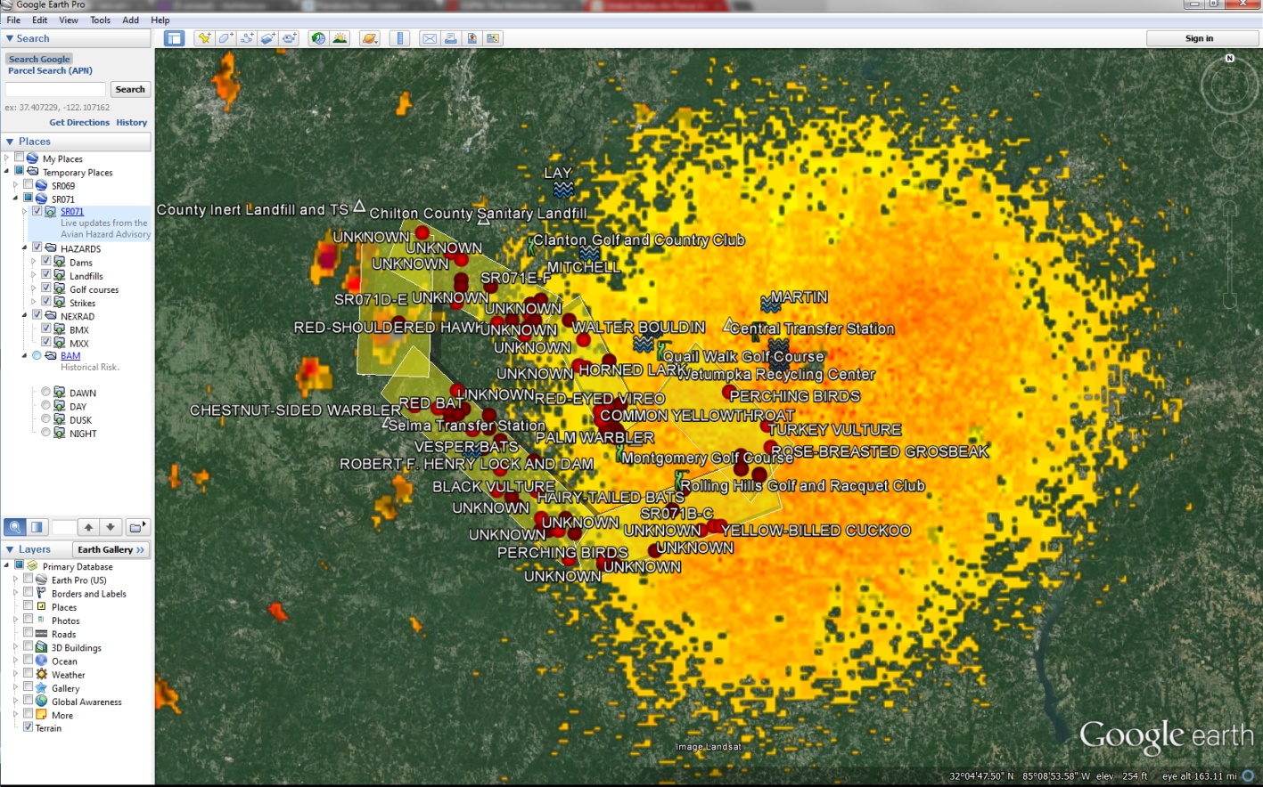
GOOGLE EARTH OUTPUT (available only on Google Earth enabled computers)
Search Criteria: SR 071, current hour
Risk matches table results and auto updates every 6-10 minutes
Hazards can be turned on or off, ON in this image
BAM layers can be turned on or off, OFF in this image
Route segment color defines warning level
Green = Low
Yellow = Moderate
Red = Severe
Outputs

Slide 12
CURRENT HOUR QUERY
Current Condition Query
Uses NEXRAD weather radar system (updated every 6-10 minutes) to monitor large-scale migratory bird activity in the CONUS and Alaska
Includes risk from migration and soaring bird activity
Risk displayed defaults to the most severe prediction model (NEXRAD, Migration, or Soaring)
Displayed thermal depth height offers maximum altitude and below where conditions are optimal for hazardous soaring birds to be present
May use BAM data if no other inputs are available
“Based On” field indicates primary source of risk
Queries

Slide 13
CURRENT HOUR QUERY Calculating NEXRAD risk
AHAS uses two factors to calculate NEXRAD risk: “Severity” is based on the dBZ (decibels of Z, where Z represents the energy reflected back to the radar) and “Probability” of a bird strike (percentage of area polygon filled with reflectable biological activity)
AHAS calculates NEXRAD risk by multiplying Severity and Probability to get a value in the below table (Green = Low, Yellow = Moderate, and Red = Severe)
 | Probability
Severity(z) | 20 | 40 | 60 | 80 | 100
3 | 60 | 120 | 180 | 240 | 300
10 | 200 | 400 | 600 | 800 | 1000
30 | 600 | 1200 | 1800 | 2400 | 3000
100 | 2000 | 4000 | 6000 | 8000 | 10000
300 | 6000 | 12000 | 18000 | 24000 | 30000
Queries

Slide 14
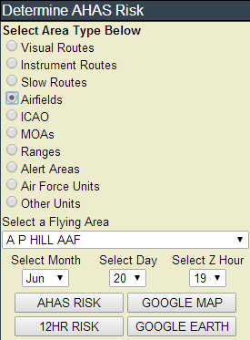
CURRENT HOUR QUERY
Query Example – A P HILL AAF
Go to www.usahas.com
Click desired area (1, Airfields)
Select A P HILL(2), current hour in Zulu (3), and output format (4)
Note: Airfield Category predicts conditions above and in a 5 nautical mile radius around the airfields and not on the fields themselves
Actual airfield conditions should be determined by observed conditions and relayed through BWC
1
2
3
4
Queries

Slide 15
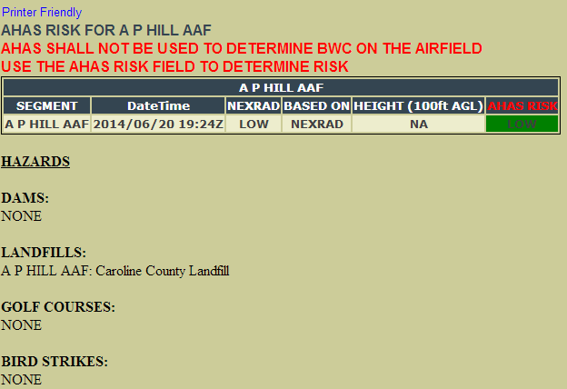
CURRENT HOUR QUERY
Defines which model/input is driving the risk reading; in this case, NEXRAD Model
Overall AHAS risk driven by highest risk model; NEXRAD model overrides any ties
NEXRAD risk:
“NO DATA” indicates that the radar is down
Thermal depth: indicates max altitude (AGL) where soaring birds might be present. In this case, “NA” indicates that the risk is not based on the soaring model. “NO DATA” indicates that the soaring data is missing
Date time of risk
Hazards
Queries

Slide 16
FORECAST QUERY (>1 and up to 24 hours)
Forecast Conditions Query
NWS weather observations and forecast model data predict large-scale migratory and soaring bird activity in the contiguous 48 states and Alaska
Migratory and Soaring models are run twice a day to forecast bird strike risk up to 24 hours in advance
The Migratory Bird Forecast Model predicts likelihood of migration of known concentrations of large birds, given current and forecast weather conditions
The Soaring Bird Forecast Model predicts likelihood of soaring birds based on calculating thermal depth and US BAM data
Displayed thermal depth height indicates where conditions are right for soaring birds to be present
Queries

Slide 17
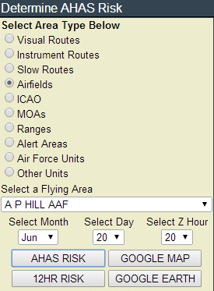
FORECAST QUERY (>1 and up to 24 hours)
Query Example – AP Hill
Go to www.usahas.com
Click desired area (Airfields)
Select AP Hill, desired time, and select output format
Everything is the same as a current hour query except you select a time between 1 and 24 hrs from current time
Next hour selected
Queries

Slide 18
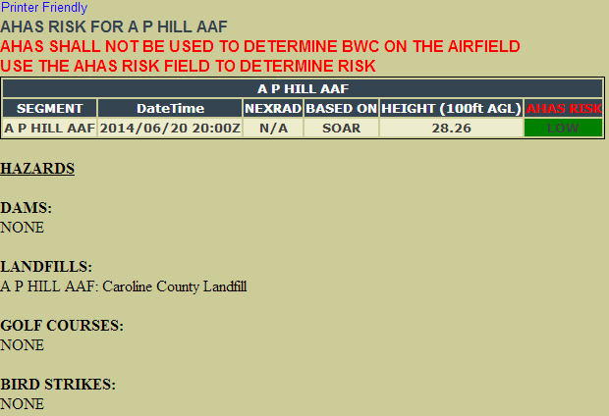
FORECAST QUERY (>1 and up to 24 hours)
Outside of 1 hour NEXRAD data is not available.
Thermal depth: indicates max altitude (AGL) where soaring birds might be present. In this case, “28.26” indicates that conditions are right for soaring birds to be present at 2,826’ AGL and below
Query is from between 1 and 24 hours of the current time
Defines which model/input is driving the risk reading. In this case, SOAR Model
Queries

Slide 19
HISTORICAL QUERY (>24 hrs or the past)
AHAS risk prediction reverts to the BAM if:
Query is for any time prior to the current hour
Query is for time period >24 hrs in advance of the current hour
Other data sources are unavailable
Past data can be requested from the USAF BASH Team
Queries

Slide 20
HISTORICAL QUERY (>24 hrs or the past)
Bird Avoidance Model (BAM) data is based on:
All bird species present during a particular daily time period, in a particular area, for one of 26 two-week periods in a year
Geographic information for observations of 60 key BASH species, over a 30-year period
Several key datasets, including the Audubon Society’s Christmas Bird Count (CBC), the US Biological Survey's Breeding Bird Survey (BBS), bird refuge arrival and departure data for the conterminous US, and data specific to a particular bird species
Common behavior of species groups modeled for dawn, day, dusk, and night
Queries

Slide 21
COMMON PITFALLS
Misperception: historical data from AHAS contains forecasted or current hour data
Requested historical data is from the US BAM only
Using AHAS to determine Bird Watch Condition code
AHAS is not precise enough for use within airfield boundaries
Expecting NEXRAD data for forecasted and historical queries
NEXRAD is updated every 6-10 minutes for current hour queries only and can not be forecasted or give historical data at this time
Pitfalls

Slide 22
BEST PRACTICES
Use BAM data when acquiring route times
Adjust/modify routes based on AHAS forecasts
Use BAM in conjunction with AHAS during planning
Pinpoint wildlife attractants along route of flight
Identify NEXRAD coverage areas or nearest radar to route
Access AHAS just prior to step time
Incorporate ops procedures in local BASH plan
Call SOF/Sqdn Ops to get current AHAS reading prior to base departure, low-level segments, or when approaching airfield/training area
Utilize Unit Specific AHAS Web Pages
Best Practices

Slide 23
BEST PRACTICES (Unit Web Pages)
Unit Web Pages can include:
Transition bases
Flight routes
Ops and Range Areas
Specific data impacting mission
Unit Web Pages are ideal for:
Operations Supervisors
SOFs
Crews stepping to fly
Unit Web Pages can be tailored to suit user’s needs
Hazards do not display on unit web pages
Best Practices

Slide 24
CONTACT INFORMATION
USAF BASH Team
Mr. Dan Sullivan, Branch Chief daniel.sullivan.26@us.af.mil, DSN 246-5674
Mr. Ted Wilkens, Programs and Initiatives henry.wilkens.1@us.af.mil, DSN 246-5673
Lt Tiffany Robertson, Wildlife Ecologist tiffany.robertson@us.af.mil, DSN 246-5848
Commercial prefix is (505) 846-xxxx
AHAS Personnel
Mr. Ron White
ahas@detect-inc.com
Contact Info

