Slide 1
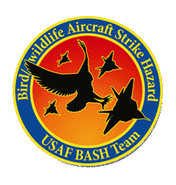
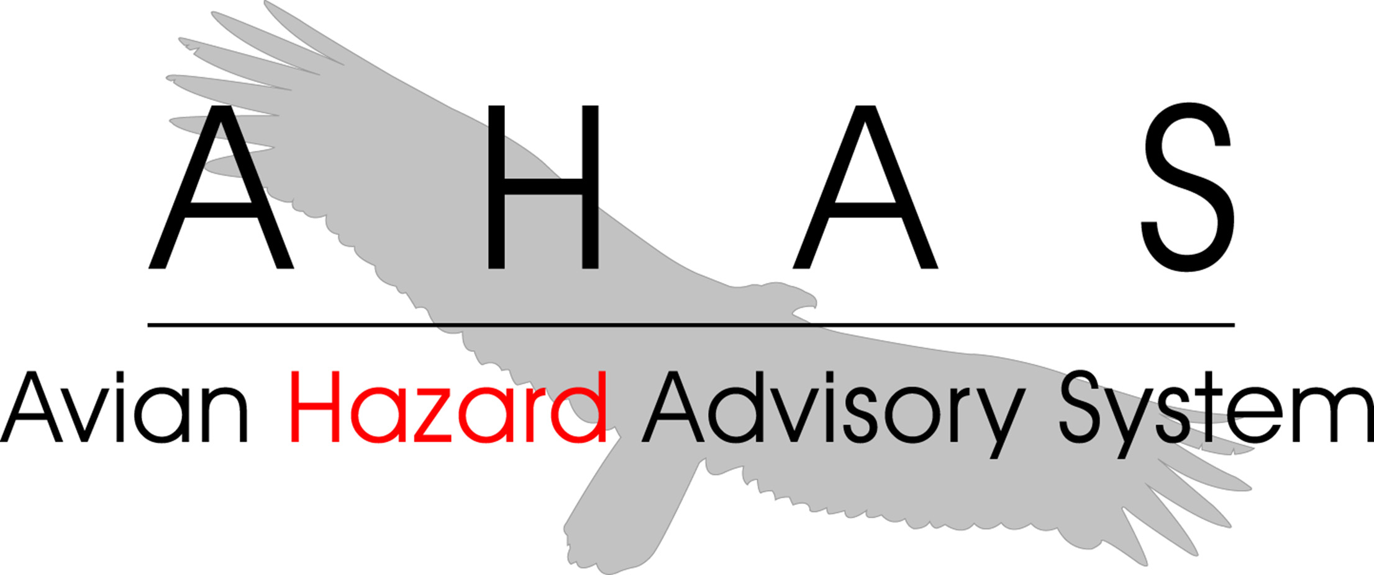
AVIAN HAZARD ADVISORY SYSTEM (AHAS)
VALIDATION
Florida : California : Hawaii : Calgary : London : Beijing
www.detect-inc.com www.dronewatcher.com
Copyright 2022, DeTect, Inc, All Rights Reserved

Slide 2
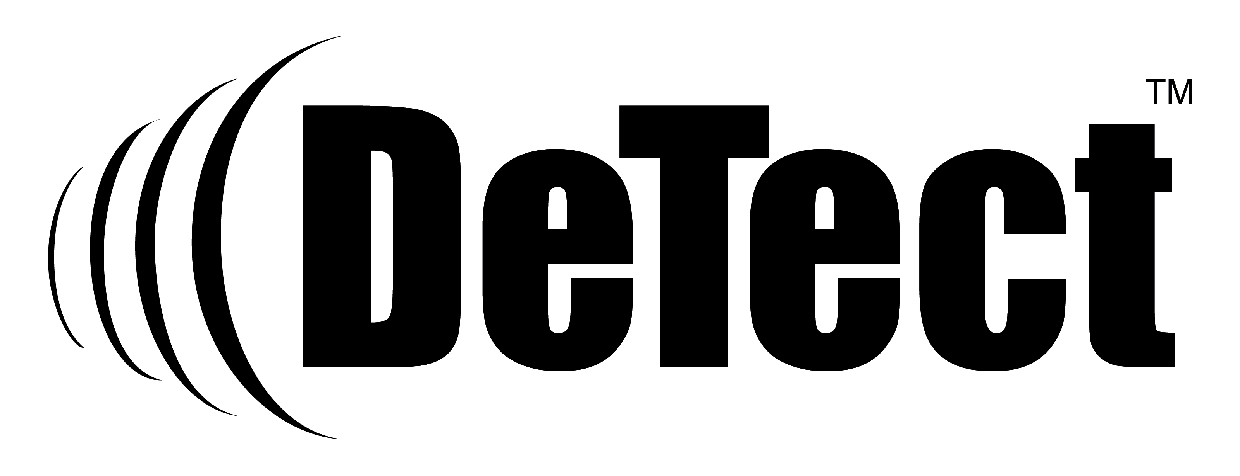
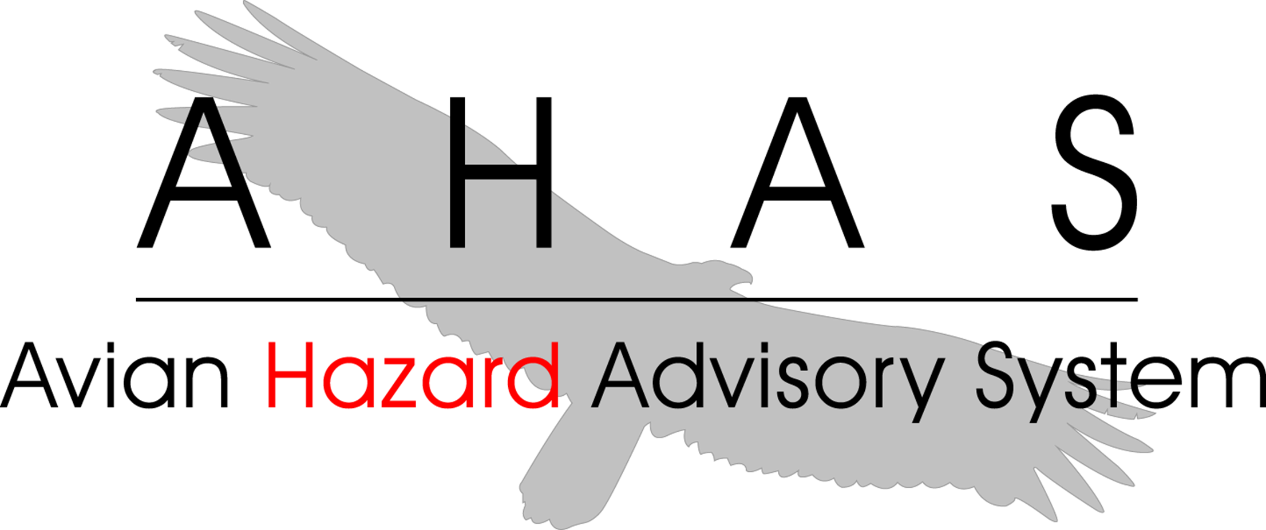
OBJECTIVE
Introduce users to how DeTect Inc. validates the NEXRAD risk as required by the Performance Work Statement(PWS)
1
Copyright 2022, DeTect, Inc, All Rights Reserved

Slide 3
OVERVIEW
What is AHAS?
Performance Work Statement (PWS)
Calculating NEXRAD risk
Validation
2
Copyright 2022, DeTect, Inc, All Rights Reserved

Slide 4
AHAS
Tracks bird movements within low level flight arena for the contiguous 48 states and Alaska
Found at https://www.usahas.com
Uses Level 2 NEXRAD data, National Weather Service (NWS) Forecasts, Soaring Bird Forecast Models, and the Bird Avoidance Model (BAM) to track bird movements
Provides CONUS and Alaska bird strike risk for:
IR, VR, and SR routes
Ranges and MOA’s
Some Military and Civilian Airfields
Alert Areas
3
Copyright 2022, DeTect, Inc, All Rights Reserved

Slide 5
PERFORMANCE WORK STATEMENT
PWS Section 6.1.4. Validate Radar Risk Prediction.
The contractor shall review and validate data collected from WSR-88D sites, utilizing available technology including but not limited to: electronic imagery, BDR data, thermal imagery, and/or visual observations. Annually, two on-site validations and a minimum of ten remote validations will be performed for locations covered by the AHAS system. At a minimum, one AHAS system validation will be executed each month.
On-site validation will include travel to an installation within the continental United States covered by AHAS, approved by the COR. Validation results shall be noted within the MSRs. Validation information collected and reported in the MSR will include: dates of validation, routes evaluated, data source used for verification, and outcome if validation is unconfirmed.
3
Copyright 2022, DeTect, Inc, All Rights Reserved

Slide 6
CALCULATING NEXRAD RISK
RASTER LAYERS
REGIONAL MOSAICS
FLYING AREAS
EXTRACTION
OPERATIONAL RISK MANAGEMENT (ORM)
4
Copyright 2022, DeTect, Inc, All Rights Reserved

Slide 7
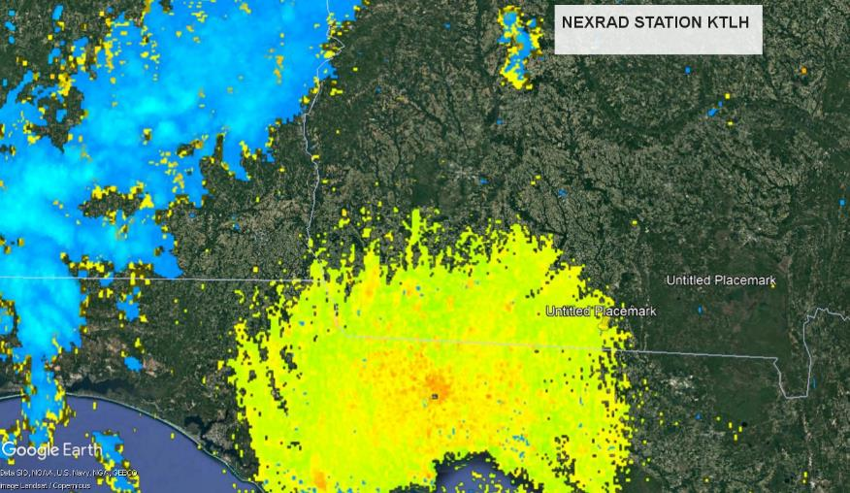
RASTER IMAGES
AHAS downloads data from the NOAA Amazon web services (AWS) and converts the raw data into a 640x427 raster images. Then the weather suppression software removes the weather from the image. AHAS does this for 169 NEXRAD stations. This image shows station KTLH in Google Earth.
5
Copyright 2022, DeTect, Inc, All Rights Reserved

Slide 8
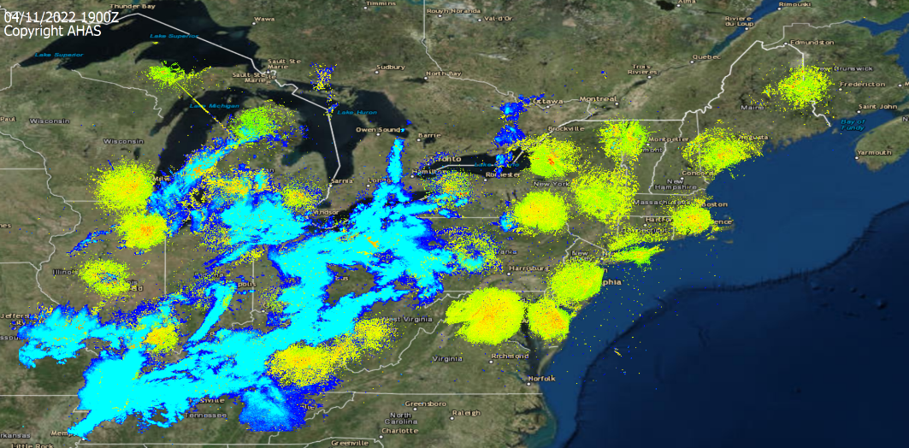
REGIONAL MOSAICS
Every six minutes AHAS concatenates the individual radar raster images into regional raster layers. This images shows the NE region in Google Earth.
6
Copyright 2022, DeTect, Inc, All Rights Reserved

Slide 9
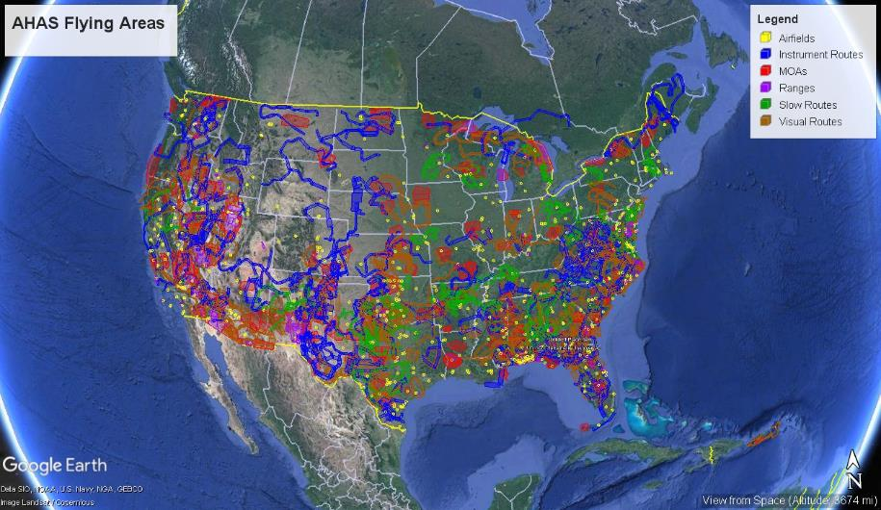
FLYING AREAS
The flying layers are also in raster layers. This image shows all of the flying areas in Google Earth.
7
Copyright 2022, DeTect, Inc, All Rights Reserved

Slide 10
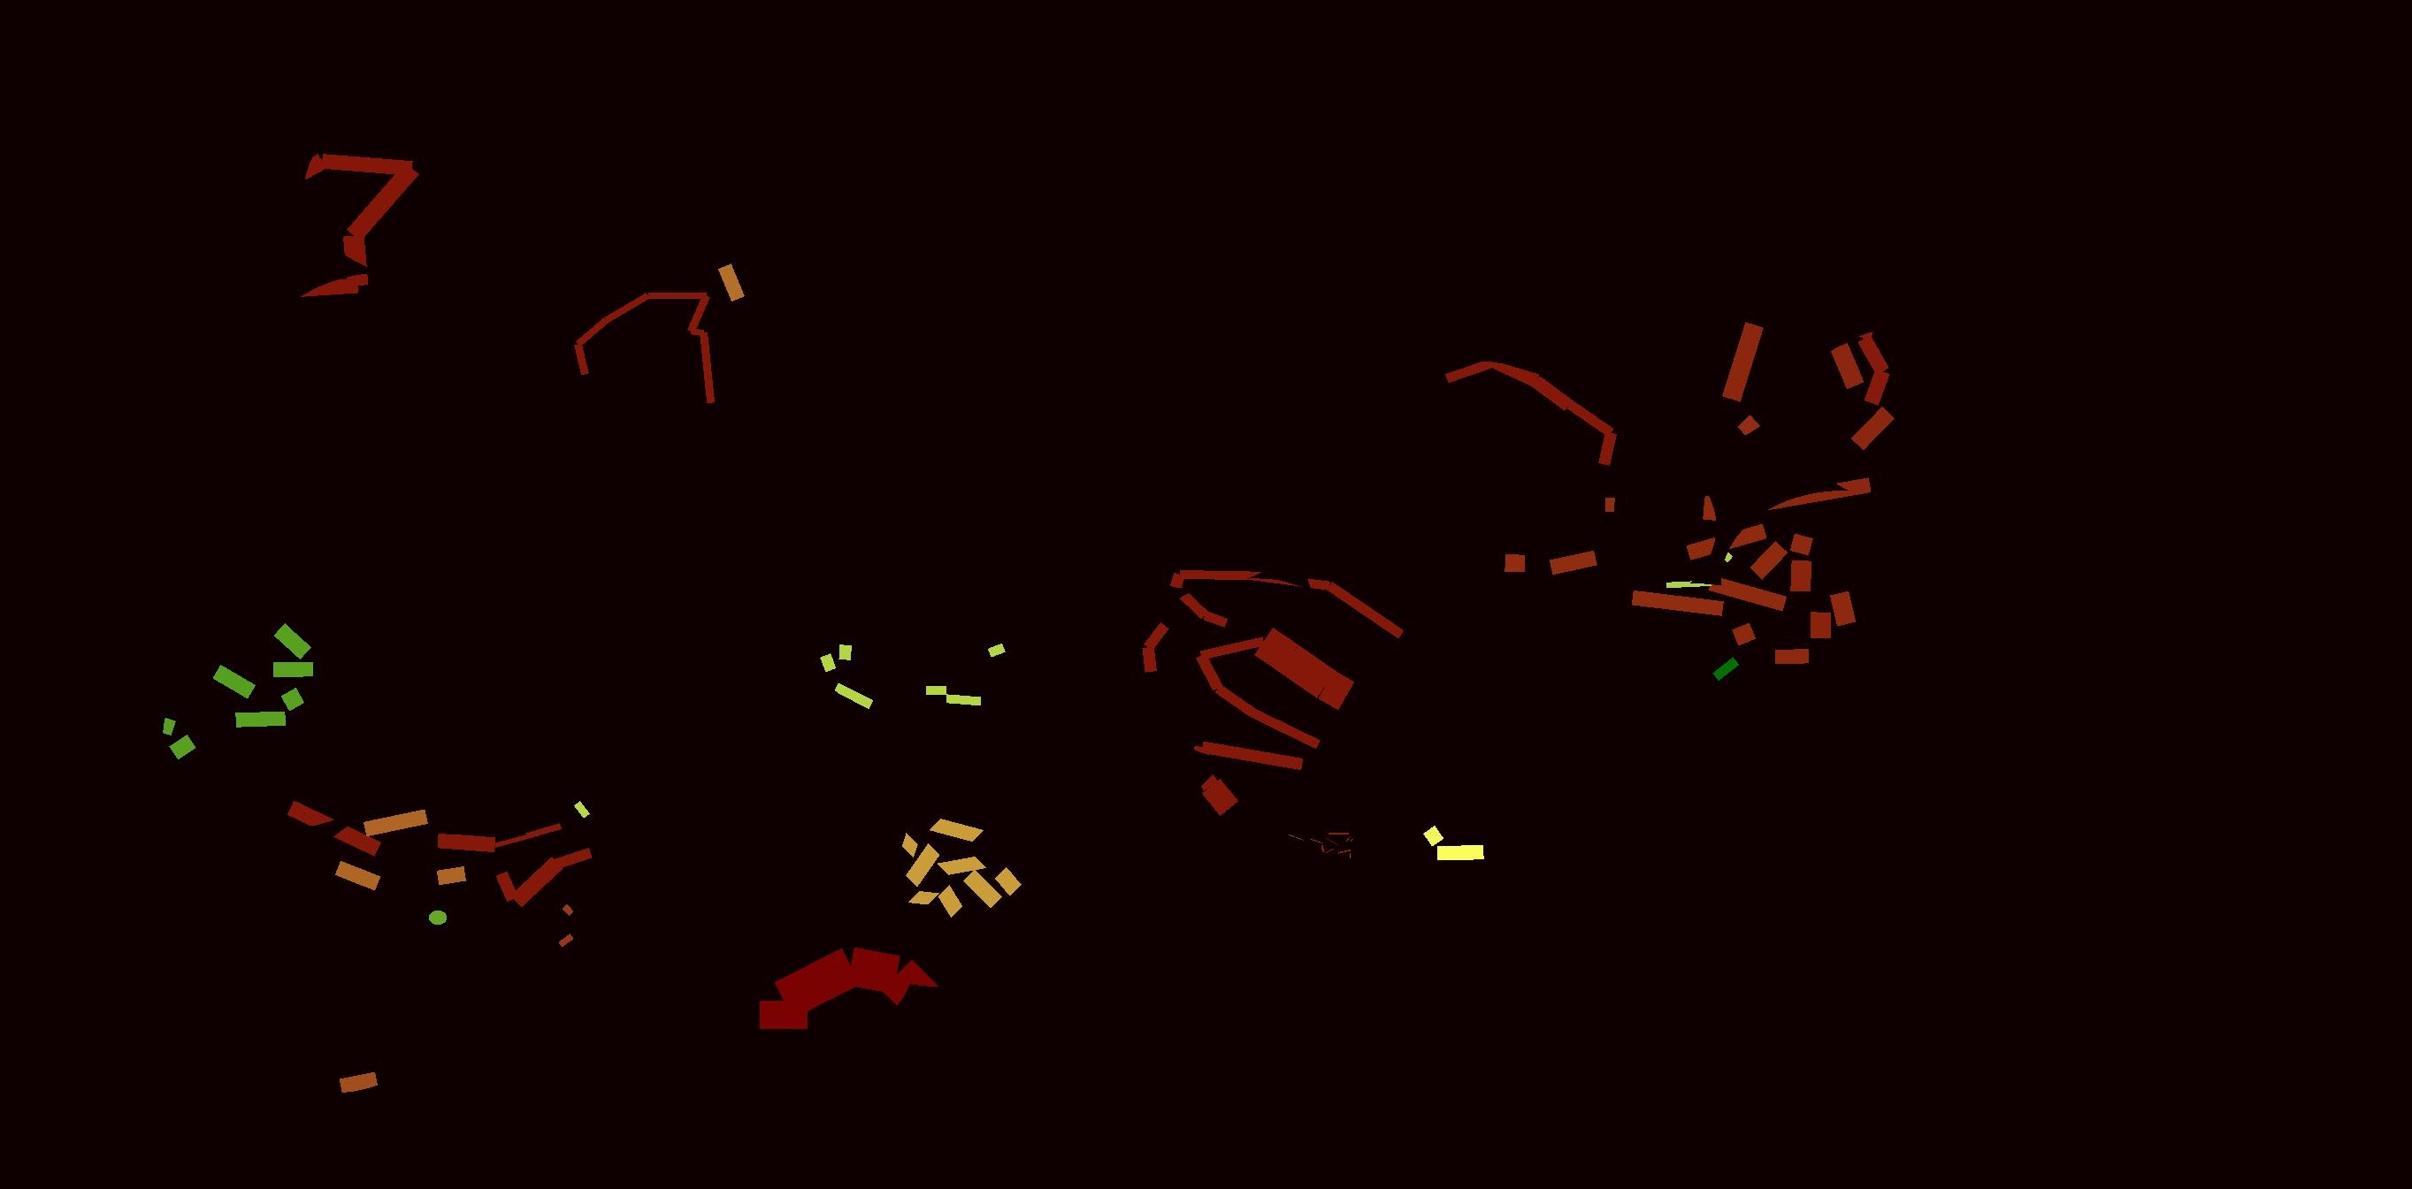
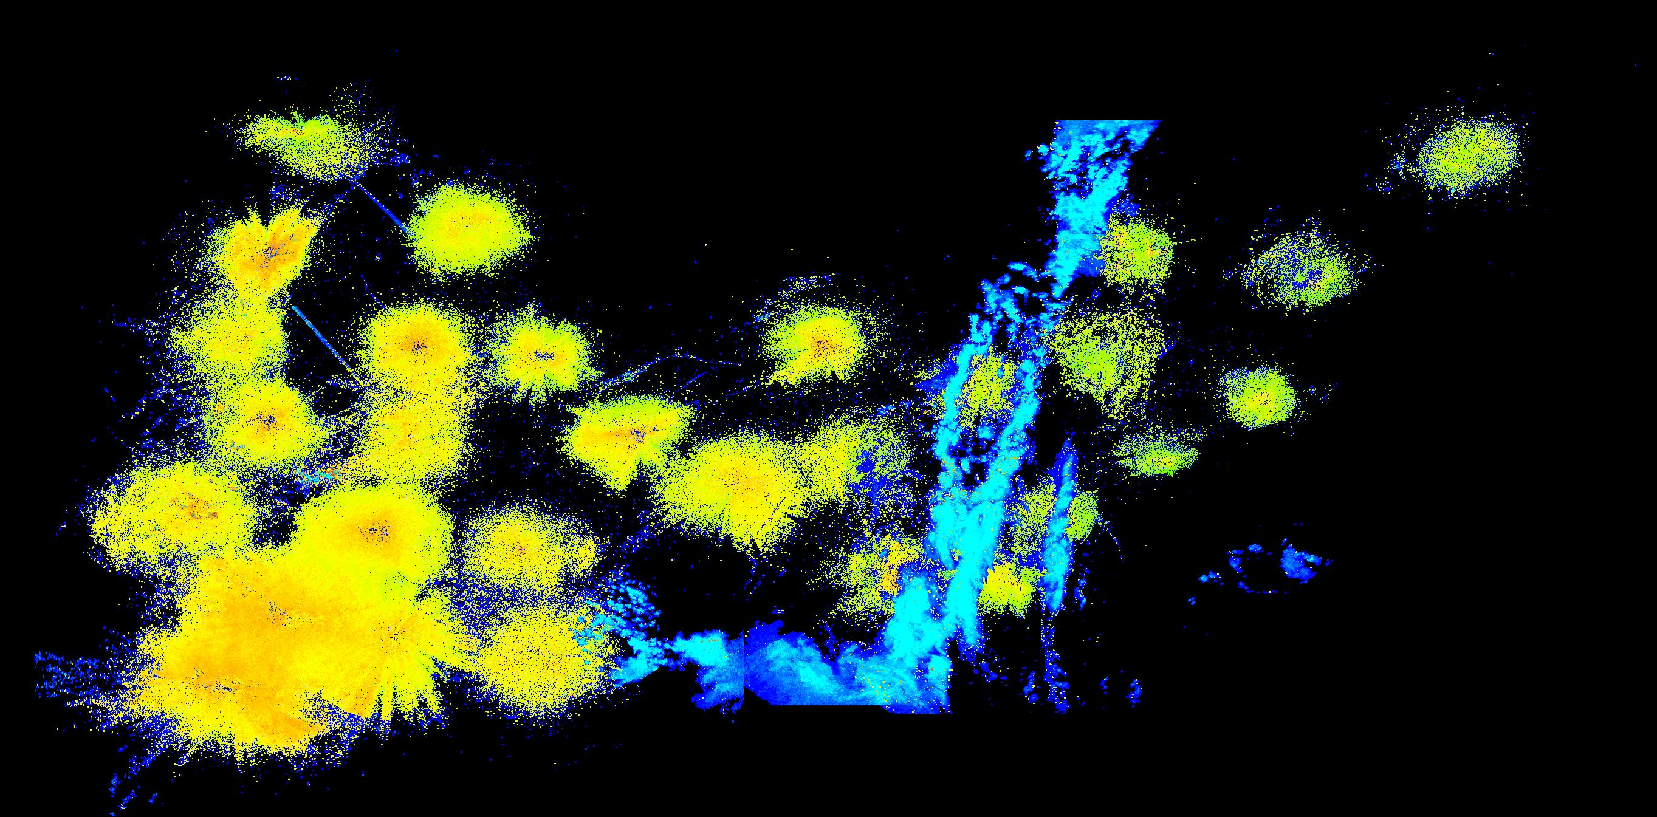
EXTRACTION
After the mosaics are created, the percentage of the polygon that has biological activity and the average dBZ value of the NEXRAD return are extracted for each flying area.
8
Copyright 2022, DeTect, Inc, All Rights Reserved

Slide 11
ORM
The risk is determined by the Operation Risk Management chart (ORM).
Probability is a function of the percentage of pixels with biological radar returns within any risk polygon (MOA, Route Segment, Airfield).
Severity of outcome is a function of the average reflectivity(dBZ) values within the risk polygon.
The higher the reflectivity values, the greater the biomass in that area of airspace.
<= 300 = Low, > 4000 = Severe
 | Probability
Severity (z) | 20 | 40 | 60 | 80 | 100
3 | 60 | 120 | 180 | 240 | 300
10 | 200 | 400 | 600 | 800 | 1000
30 | 600 | 1200 | 1800 | 2400 | 3000
100 | 2000 | 4000 | 6000 | 8000 | 10000
300 | 6000 | 12000 | 18000 | 24000 | 30000
9
Copyright 2022, DeTect, Inc, All Rights Reserved

Slide 12
VALIDATION
Weather Suppression.
Risk Validation
Visual Observations
10
Copyright 2022, DeTect, Inc, All Rights Reserved

Slide 13
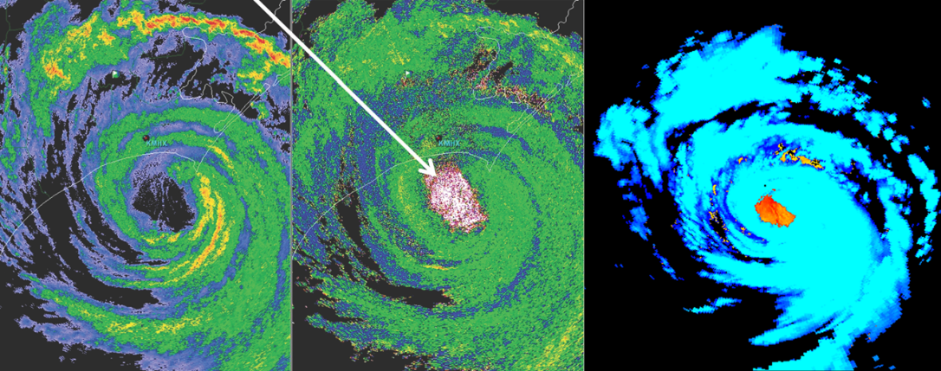
WEATHER SUPPRESSION
Radar analysis from the University of Alabama-Huntsville’s Severe Weather Institute indicates birds trapped in the eye of hurricane Arthur (left two images).
Weather suppression software used by DeTect Inc. successfully removes the weather(blue) and retains the birds circled.
NEXRAD station KMHX, 4 July 2014.
11
Copyright 2022, DeTect, Inc, All Rights Reserved

Slide 14
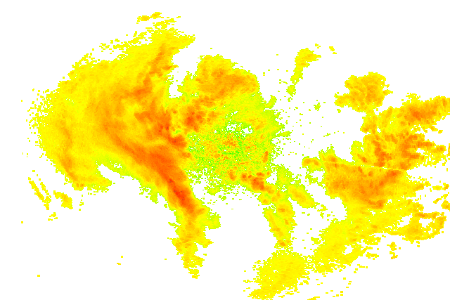
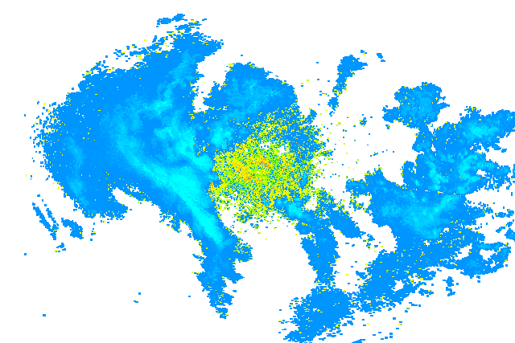
WEATHER SUPPRESSION
NEXRAD station KGGW, 9 May, 2022. Raw image on the left and weather suppressed image on the right.
12
Copyright 2022, DeTect, Inc, All Rights Reserved

Slide 15
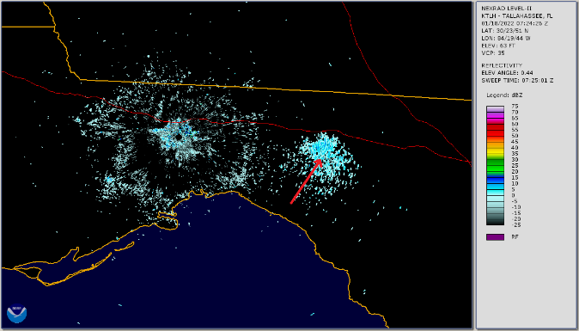
RISK VALIDATION
On January 18th NEXRAD data was used to observe several roost departures east of the NEXRAD in Tallahassee(KTLH).
At 0703Z the largest roost appeared on the NEXRAD (Image 1)
This roost departure was notable because it was during the hours of darkness
Roost rings typically appear at dawn or dusk.
13
Copyright 2022, DeTect, Inc, All Rights Reserved

Slide 16
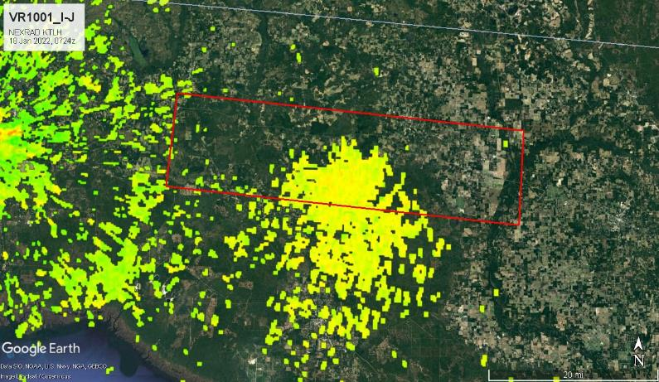
RISK VALIDATION
VR1001 is the only route segment directly impacted by the bird roost.
14
Copyright 2022, DeTect, Inc, All Rights Reserved

Slide 17
RISK VALIDATION
VR1001 is the only route segment directly impacted by the bird roost. The table below shows the increased probability and severity caused by the bird activity.
Date Z | Segment | Max_Z | Severity | Probability
2022-01-18 6:54:38z | VR1001I-J | 3.162278 | 0.754781 | 9.641873
2022-01-18 7:00:39z | VR1001I-J | 3.981072 | 0.735124 | 10.7438
2022-01-18 7:06:39z | VR1001I-J | 5.011872 | 0.865152 | 11.29477
2022-01-18 7:12:40z | VR1001I-J | 7.943282 | 0.983121 | 16.62075
2022-01-18 7:18:41z | VR1001I-J | 7.943282 | 1.311714 | 17.53903
2022-01-18 7:24:41z | VR1001I-J | 15.84893 | 2.092311 | 21.21212
2022-01-18 7:30:42z | VR1001I-J | 15.84893 | 2.256227 | 22.95684
2022-01-18 7:36:32z | VR1001I-J | 15.84893 | 2.698961 | 26.07897
2022-01-18 7:42:32z | VR1001I-J | 15.84893 | 1.842718 | 27.36456
2022-01-18 7:48:33z | VR1001I-J | 6.309573 | 1.168536 | 22.68136
2022-01-18 7:54:33z | VR1001I-J | 5.011872 | 0.900888 | 20.20202
2022-01-18 8:00:34z | VR1001I-J | 5.011872 | 0.974576 | 19.10009
15
Copyright 2022, DeTect, Inc, All Rights Reserved

Slide 18
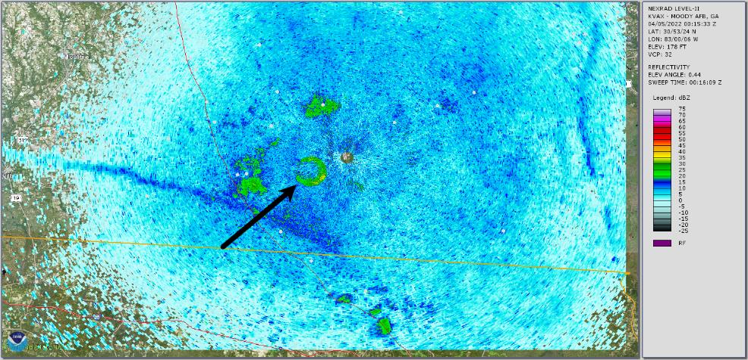
VISUAL OBSERVATIONS
DeTect staff member, Tim West, noted several bat roosts in GA and sent the locations to Katrina Morris with the GA Wildlife Resources Division.
16
Copyright 2022, DeTect, Inc, All Rights Reserved

Slide 19
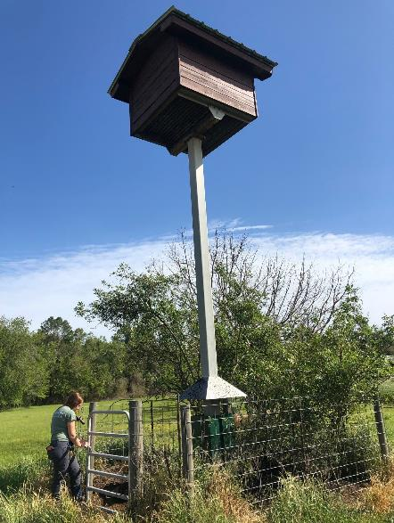
VISUAL OBSERVATIONS
On 30 March 2022, Katrina investigated one of those roosts near Valdosta Georgia. Bats were observed living in a large bat condo created by a private citizen as well as multiple bat houses.
This bat condo has 46 chambers and is about 5 feet by 5 feet by 5 feet. The condo can certainly hold thousands of bats.
17
Copyright 2022, DeTect, Inc, All Rights Reserved

Slide 20
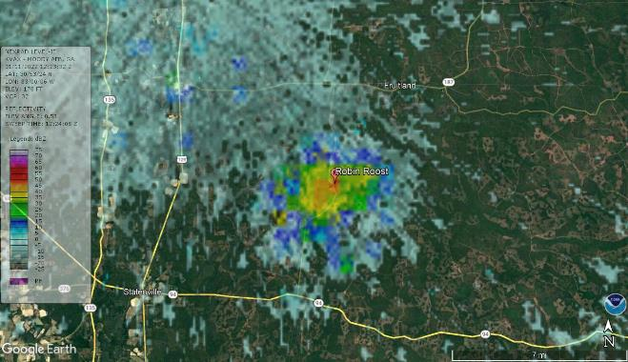
VISUAL OBSERVATIONS
On the morning of January 11th a roost was observed on NEXRAD east of Valdosta, GA.
Using NEXRAD data and Google Earth we estimated the location of the roost to be around 30°45'58.83"N, 82°53'55.15"W.
18
Copyright 2022, DeTect, Inc, All Rights Reserved

Slide 21
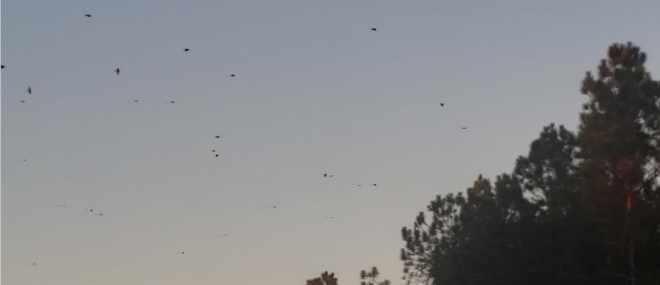
VISUAL OBSERVATIONS
When birds or bats leave the roost, sometimes it happens so fast it is hard to find the actual roost if you are in the wrong spot. We try to get a general idea of where the roost is when the birds or bats are going back to the roost.
Visual observation of Robins heading to roost on the evening of the 11th.
19
Copyright 2022, DeTect, Inc, All Rights Reserved

Slide 22
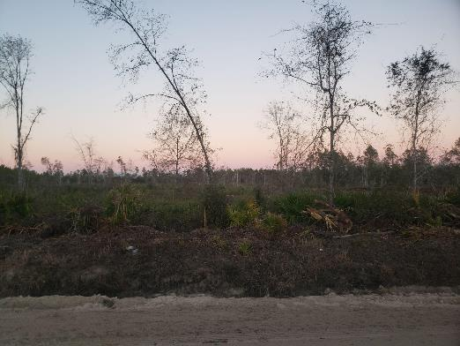
VISUAL OBSERVATIONS
In this case, I was unable to find exactly where the roost was. It’s out there somewhere inaccessible.
20
Copyright 2022, DeTect, Inc, All Rights Reserved

Slide 23
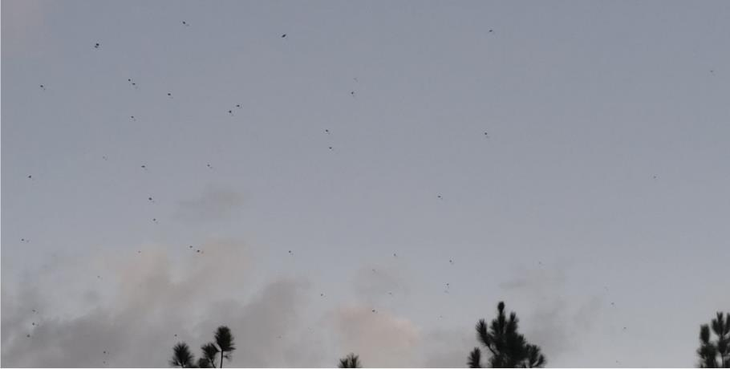
VISUAL OBSERVATIONS
The next morning I returned around sunrise to try and catch the Robins leaving at around 0700. They were observed leaving the roost area from about 0720 until 0800 local time.
21
Copyright 2022, DeTect, Inc, All Rights Reserved

Slide 24
RISK VALIDATION
Date Z | Avg Z Values | Percent | ORM value | NEXRAD RISK
1/12/2022 12:00:35 | 0.861437 | 47.80793 | 41.1835198 | LOW
1/12/2022 12:06:25 | 1.80519 | 46.76409 | 84.41806763 | LOW
1/12/2022 12:12:26 | 1.800698 | 46.97286 | 84.58393506 | LOW
1/12/2022 12:18:27 | 1.6684 | 47.80793 | 79.76275041 | LOW
1/12/2022 12:24:27 | 0.779589 | 38.72651 | 30.1907612 | LOW
1/12/2022 12:30:27 | 0.779589 | 38.72651 | 30.1907612 | LOW
1/12/2022 12:36:28 | 10.95222 | 42.48434 | 465.2978382 | MODERATE
1/12/2022 12:42:28 | 38.09919 | 31.73278 | 1208.993214 | MODERATE
1/12/2022 12:48:29 | 193.5845 | 22.96451 | 4445.573186 | SEVERE
1/12/2022 12:54:29 | 90.52348 | 27.13988 | 2456.796384 | MODERATE
1/12/2022 13:00:31 | 18.94401 | 38.20459 | 723.748135 | MODERATE
1/12/2022 13:06:31 | 20.59394 | 39.77036 | 819.0284076 | MODERATE
1/12/2022 13:12:31 | 14.21373 | 40.8142 | 580.122019 | MODERATE
1/12/2022 13:18:32 | 6.133166 | 45.4071 | 278.4892819 | LOW
1/12/2022 13:24:32 | 16.51355 | 44.0501 | 727.4235289 | MODERATE
1/12/2022 13:30:33 | 16.44141 | 44.25887 | 727.6782278 | MODERATE
1/12/2022 13:36:33 | 26.93702 | 45.09394 | 1214.696364 | MODERATE
1/12/2022 13:42:34 | 14.85974 | 44.57203 | 662.3287771 | MODERATE
1/12/2022 13:48:35 | 14.86278 | 44.57203 | 662.464276 | MODERATE
1/12/2022 13:54:35 | 13.58457 | 52.08768 | 707.5887351 | MODERATE
1/12/2022 14:00:28 | 13.41824 | 52.81837 | 708.7295651 | MODERATE
1/12/2022 14:06:26 | 14.03757 | 52.50522 | 737.0457011 | MODERATE
Instrument Route IR016 C-D passes directly over the area of the roost. The NEXRAD risk was low until the emergence when the risk increased to moderate. The risk increased to severe at 1248z (0748 local).
22
Copyright 2022, DeTect, Inc, All Rights Reserved

Slide 25
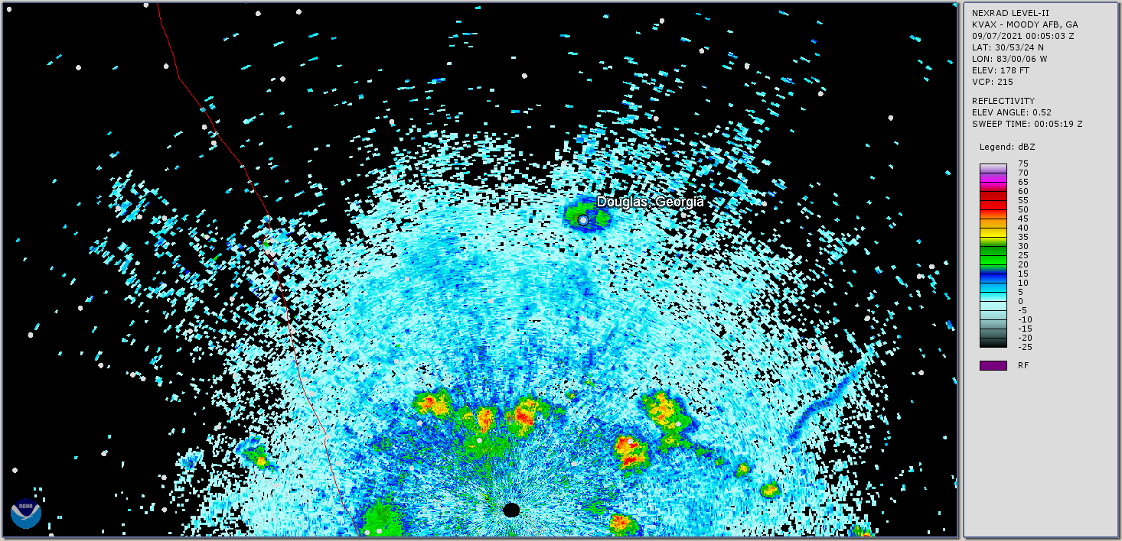
VISUAL OBSERVATIONS
A bat roost was detected, using NEXRAD data, near Douglas, GA on September 7th at coordinates approximately 30°45'58.83"N, 82°53'55.15"W. On September 8th, I travelled there to find the roost.
23
Copyright 2022, DeTect, Inc, All Rights Reserved

Slide 26
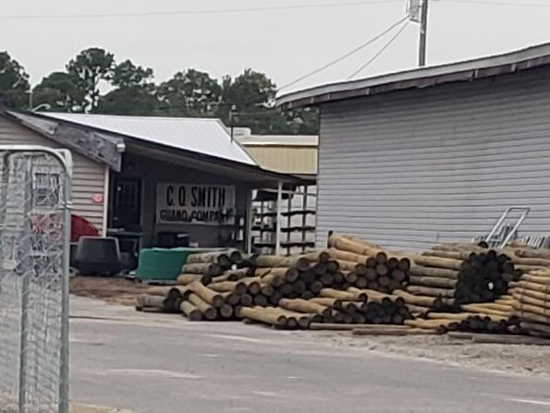
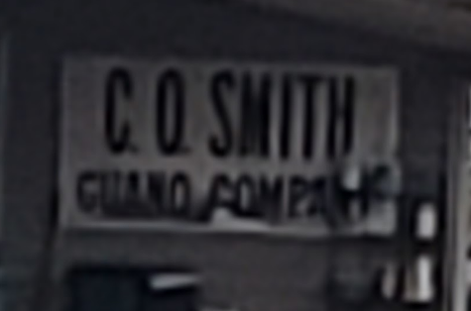
VISUAL OBSERVATIONS
To help find the exact location of the roost, DeTect contacted the Georgia Wildlife Resource Division. They knew about this roost and directed me to Waldron Farm Supply. I travelled there on September 8th.
24
Copyright 2022, DeTect, Inc, All Rights Reserved

Slide 27
VISUAL OBSERVATIONS
On the evening of the 8th of September 2021, I observed bats leaving the roost.
25
Copyright 2022, DeTect, Inc, All Rights Reserved

Slide 28
CONCLUSION
NEXRAD imagery can detect wildlife hazards in real time
NEXRAD imagery can find new roosts as they emerge for conservation efforts
Conversely AHAS will not indicate a bird or bat hazard when it is no longer present
Validating NEXRAD detections has benefits for both flight safety and conservation of wildlife.
26
Copyright 2022, DeTect, Inc, All Rights Reserved

Slide 29
Questions?
Copyright 2022, DeTect, Inc, All Rights Reserved

Slide 30
USAF BASH Team
Mr. Dan Sullivan, Branch Chief : daniel.sullivan.26@us.af.mil, DSN 246-5674
Kyle Russell, Deputy Chief : kyle.russell.17@us.af.mil, DSN 246-5674
Capt Boss, Wildlife Ecologist : patrick.boss.1@us.af.mil, DSN 246-5848
Commercial prefix : (505) 846-xxxx
AHAS Personnel
Mr. Ron White : ahas@detect-inc.com
Florida : California : Hawaii : Calgary : London : Bejing
www.detect-inc.com www.dronewatcher.com
Copyright 2022, DeTect, Inc, All Rights Reserved

Slide 31
Thank you
United States
DeTect, Inc
2817 Hwy 77,
Panama City,
Florida 32405
USA
contact@detect-inc.com
Canada
DeTect Canada International Inc.
#7 – 503 Hurricane Drive
Calgary, Alberta,
T3Z-3S8
Canada
detectca@detect-inc.com
Europe
DeTect Global, Ltd
Afron House
Worthing Road, Horsham,
Sussex, RH 12 1TL
England
detecteu@detect-inc.com
China
DeTect China
818 West 3 Building, 18 Jian Guo New Ave, Dong Cheng District,
Beijing, 100005
China
detectcn@detect-inc.com
Florida : California : Hawaii : Calgary : London : Bejing
www.detect-inc.com www.dronewatcher.com
Copyright 2021, DeTect, Inc, All Rights Reserved

